Slide 1
Module 4 final project
Zhiqiang Sun

Slide 2
Overview
For this project, we trained a pretrained CNN model to predict the Classification of the x-ray images.
Business understanding
The medical dataset comes from Kermany et al. contains a set of x-ray images of pediatric patients. The images will show whether the patients have pneumonia or not. Our task is to build a model that can classify whether a given patient has pneumonia given a chest x-ray image. Since this is an Image Classification problem, we will solve it with Deep Learning.

Slide 3
Plan
1. Downscaling the data set by randomly choosing 20% of the initial training and testing images to the new data_org_subset folder. Make a new validation folder and randomly select 5% of the pictures from the training folder.
2. Define the trained generator, validation generator, and test generator.
3. Build a baseline model.
4. Build the deep learning model base on the Pretrained CNN (VGG19) by adding a few fully connected layers. Then, train the model with selected images.
5. Retrain the model with complete training data.
6. Evaluate the model with the test images.

Slide 4
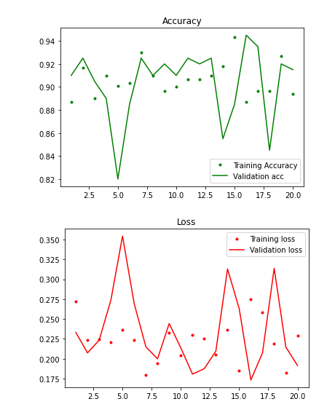
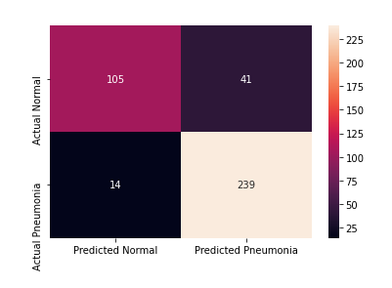
The results for the CNN model with entire data.

Slide 5
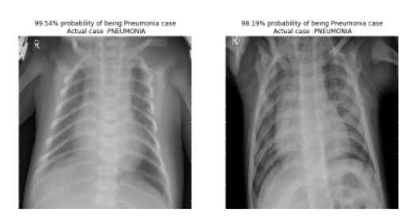
Two samples with predicted results

Slide 6
Conclusion
Based on 20% of the whole dataset, we created a CNN model based on a Pretrained model (VGG19), which can classify X-ray images as Pneumonia cases or Normal cases. The model was then retrained with the whole dataset and tested with the separated test images. The accuracy of the prediction is around 95%.

Slide 7
Thanks!
Zhiqiang Sun
sunzhiqiang04@gmail.com

